Slide 1
Tools and Supplies Checklist
Items presented in these slides is to give you an idea of what you will need for the course. Please select only one item from each slide. Please contact me If you have any questions at Jmota@yonkerspublicschools.org or jcimino@yonkerspublicschools.org

Slide 2
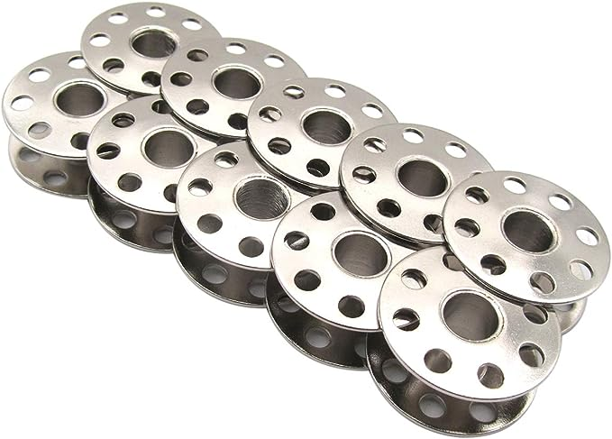
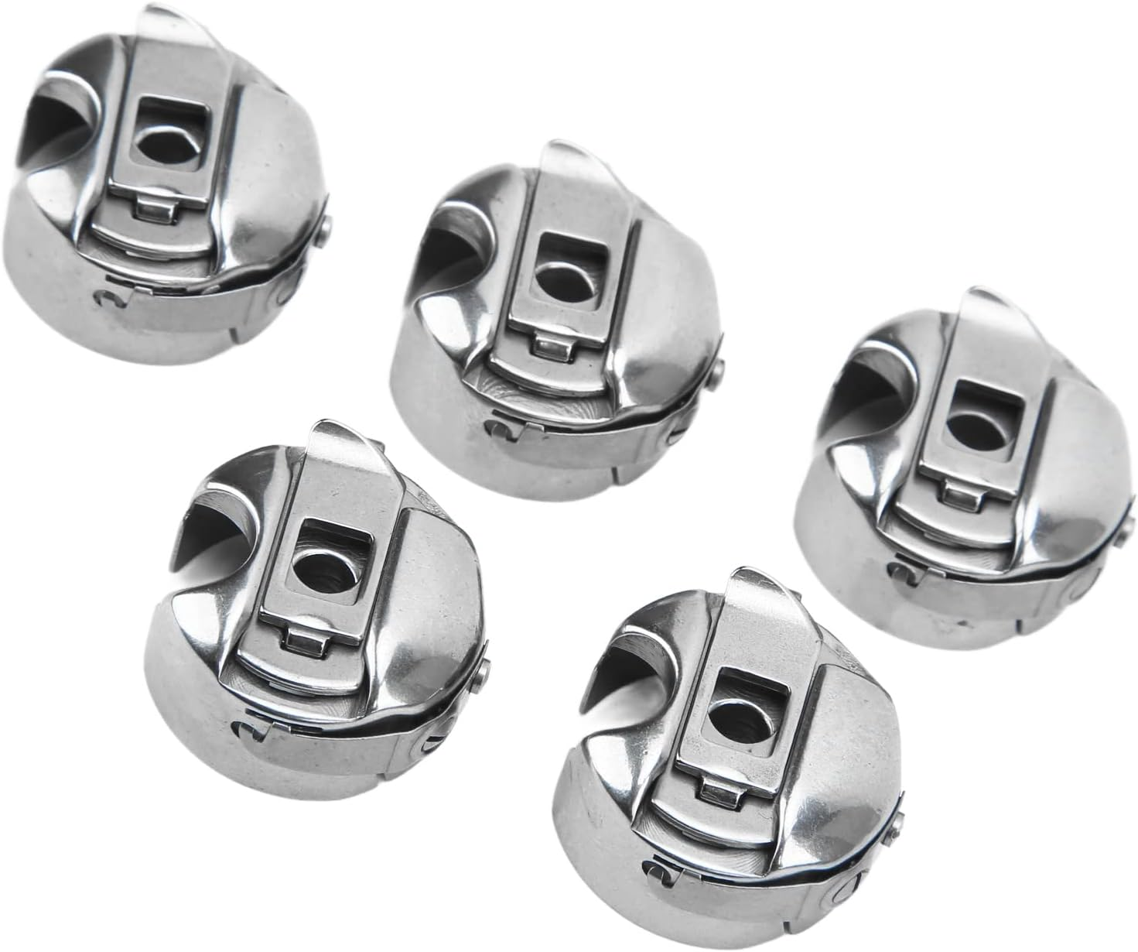
Industrial Bobbin Case & Bobbins
(Click Images for Pricing)

Slide 3
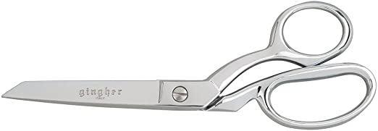
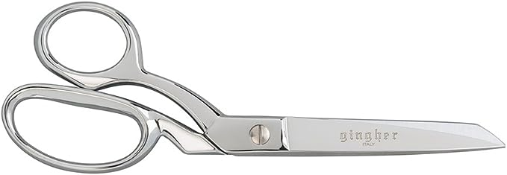
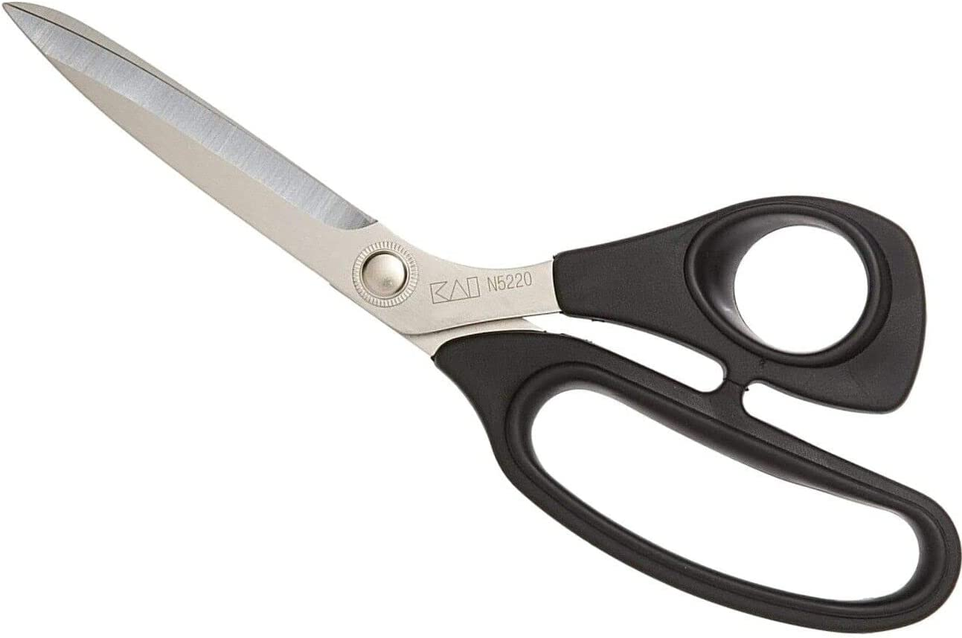
8”- 9” Dressmaking Fabric Shears
(Click Images for Pricing)
*Dressmaking shears must be bent as shown for cutting on surface of table.
*For Left Hand Use Only!
*For Left Hand Use Only!

Slide 4
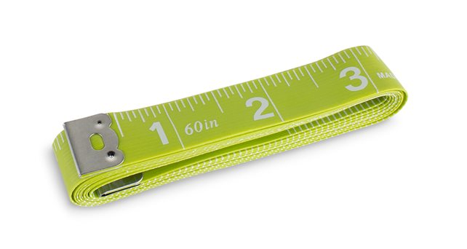
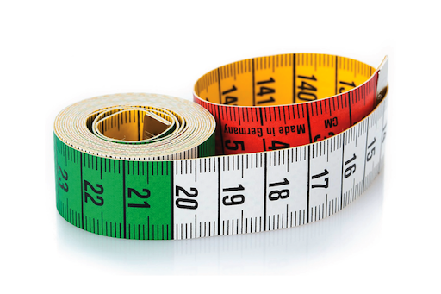
60” Measuring Tape
(Click Images for Pricing)

Slide 5
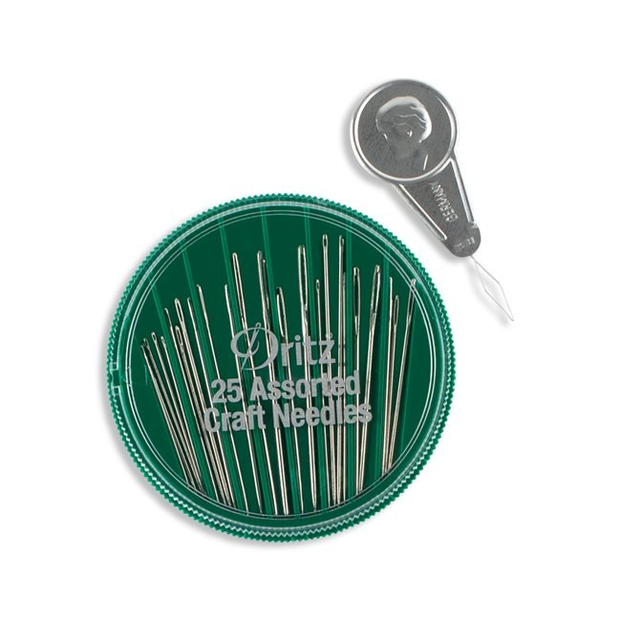
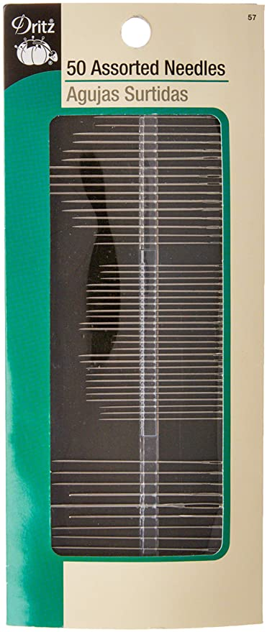
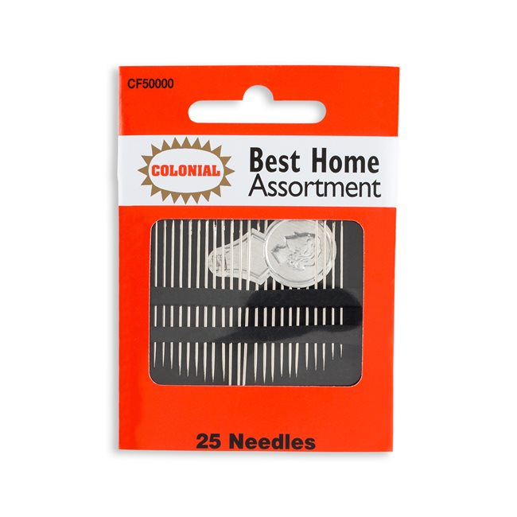
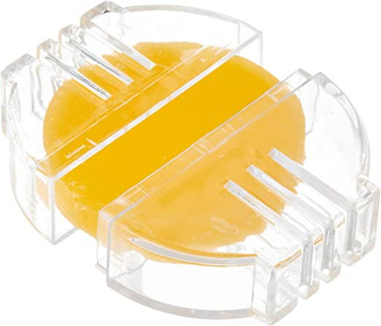
Assorted Pack of Sewing Needles
(Click Images for Pricing)
*Bees Wax for Hand Sewing.

Slide 6
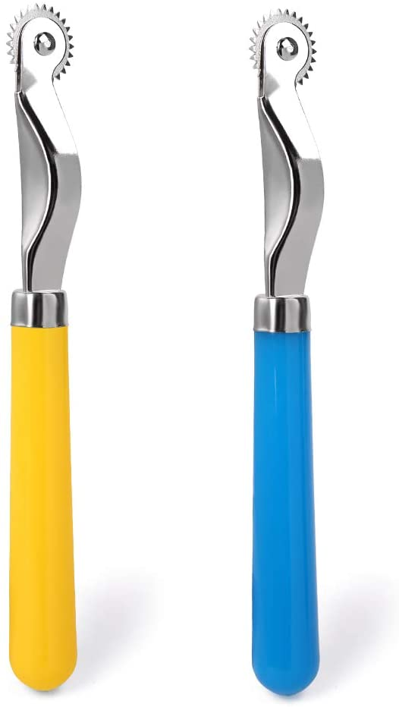
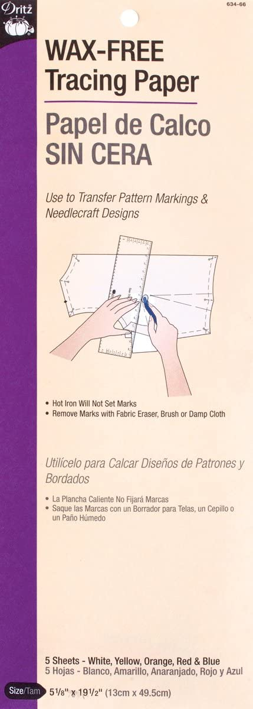
Serrated Tracing Wheel and Tracing Paper
(Click Images for Pricing)

Slide 7
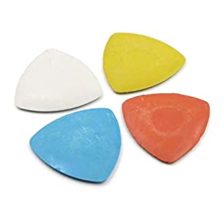
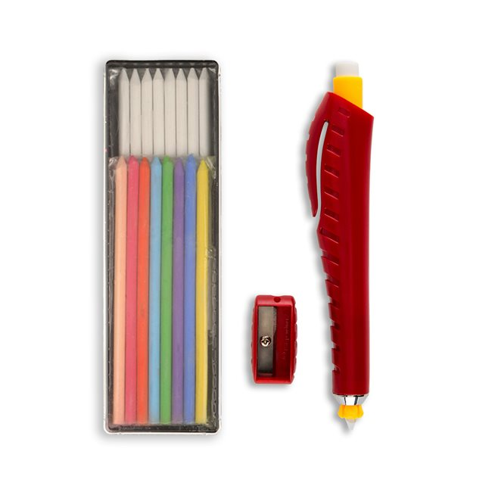
Marking Tools
(Click Images for Pricing)

Slide 8
Sliding Hem Gauge
(Click Images for Pricing)

Slide 9
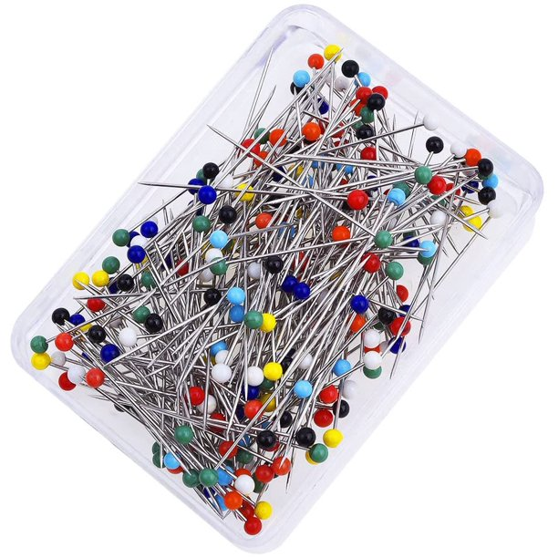
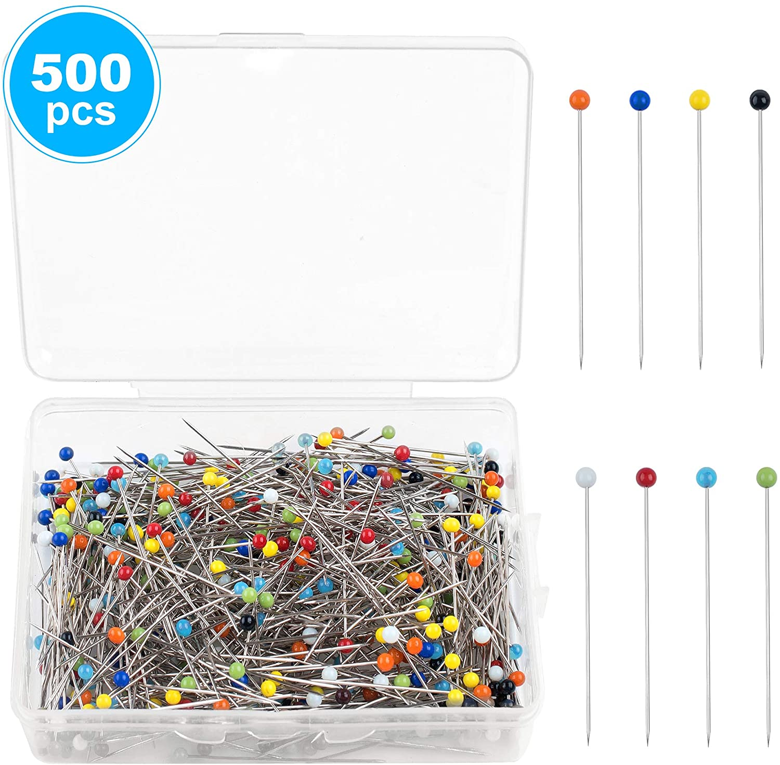
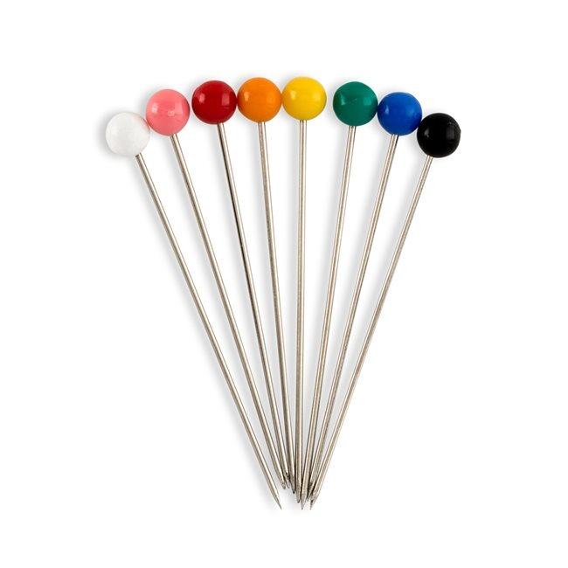
Seam Ripper and Pins
(Click Images for Pricing)

Slide 10
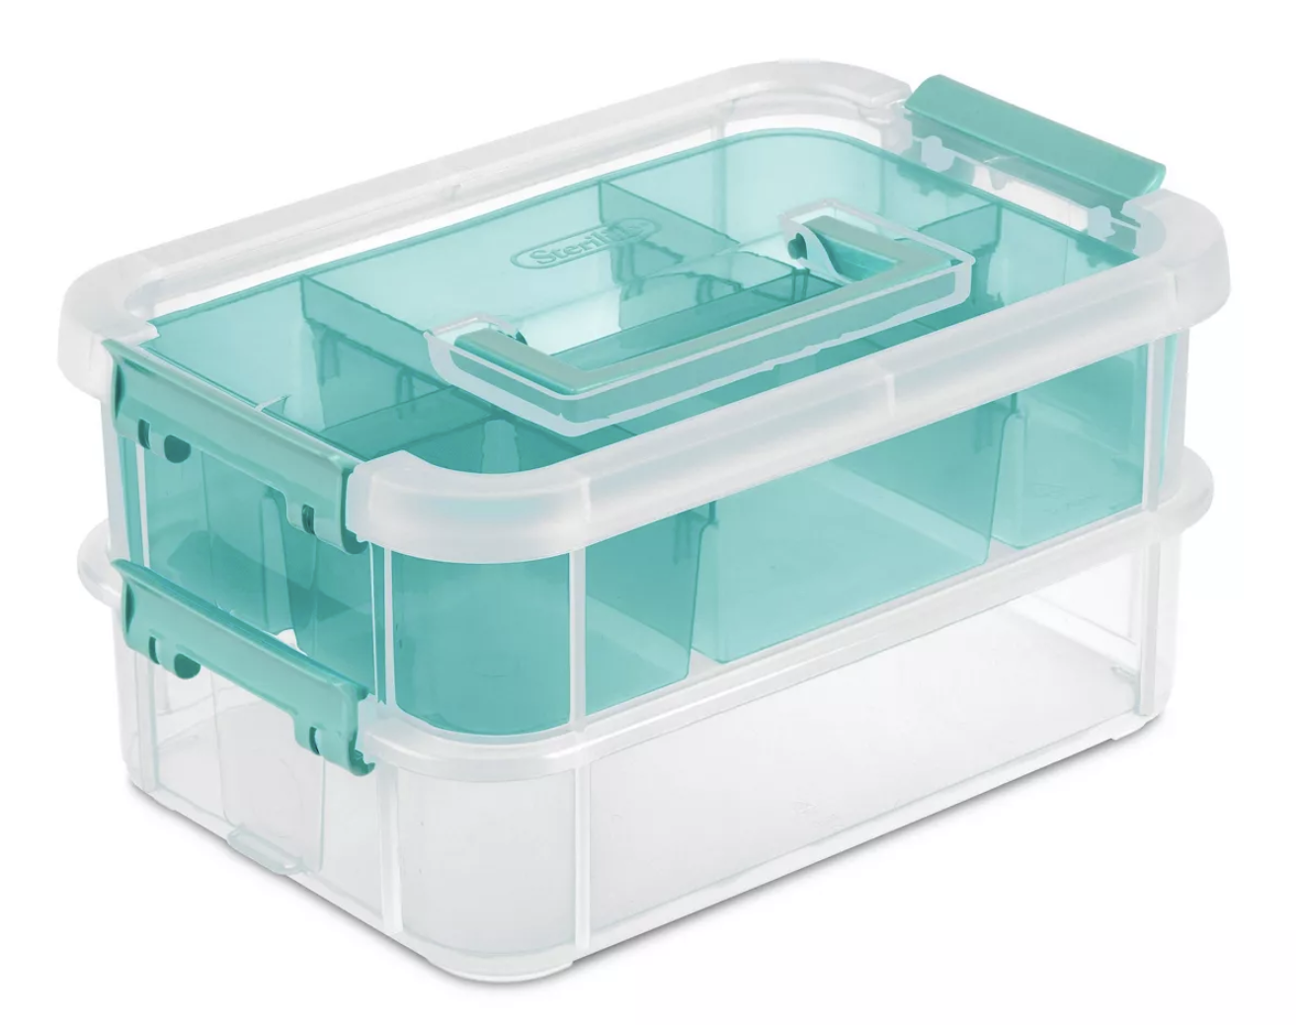
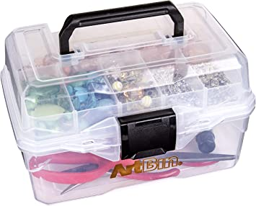
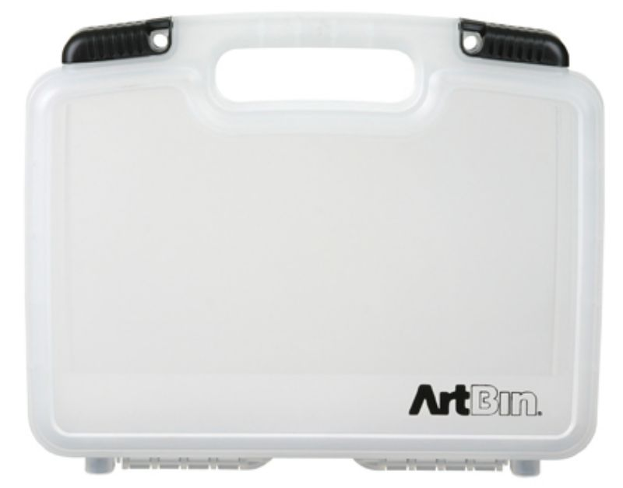
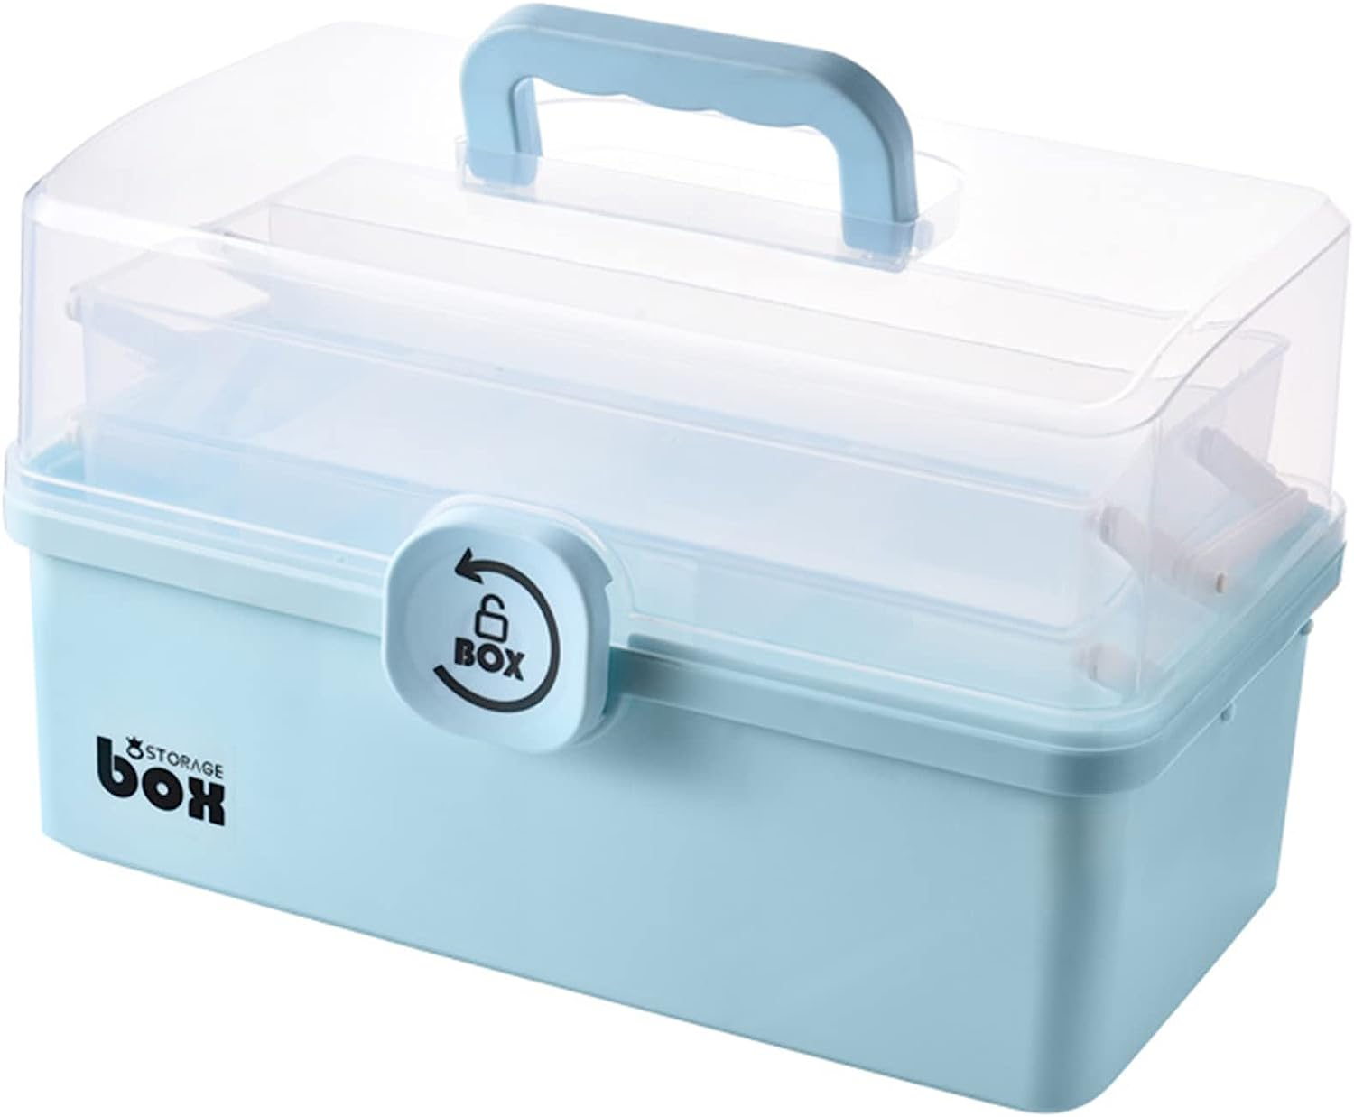
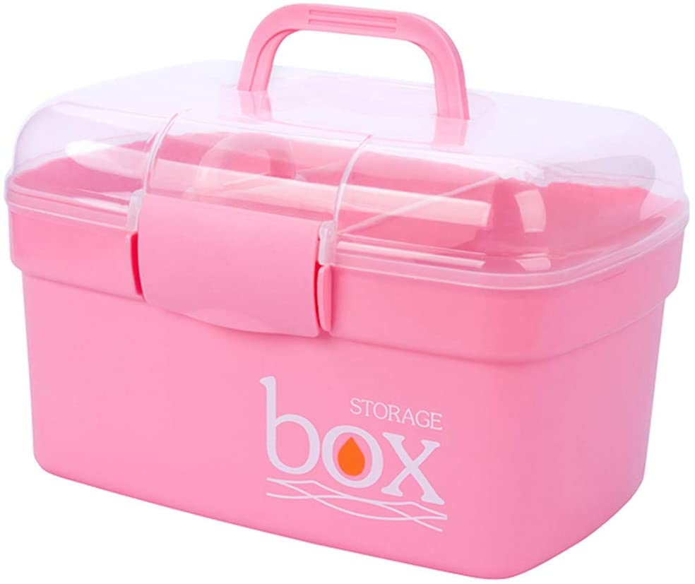
Storage Bins no bigger than 12”X6.5”X6”
(Click Images for Pricing)

Slide 11
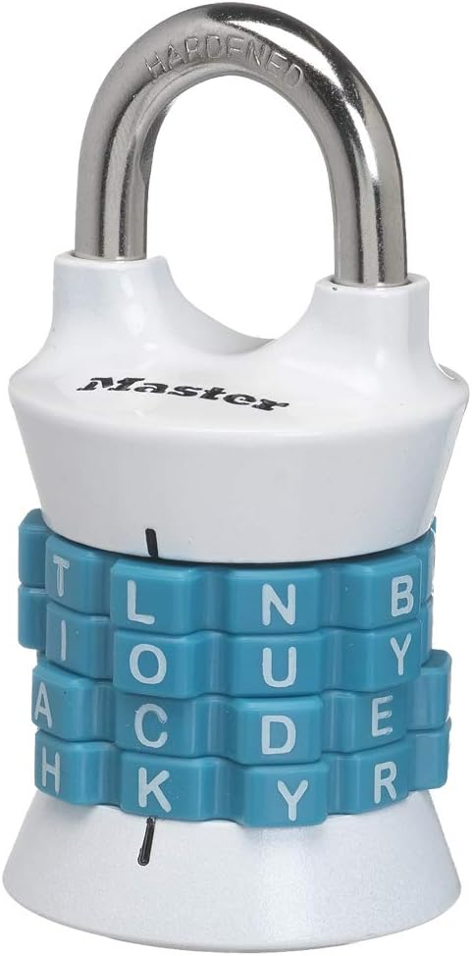
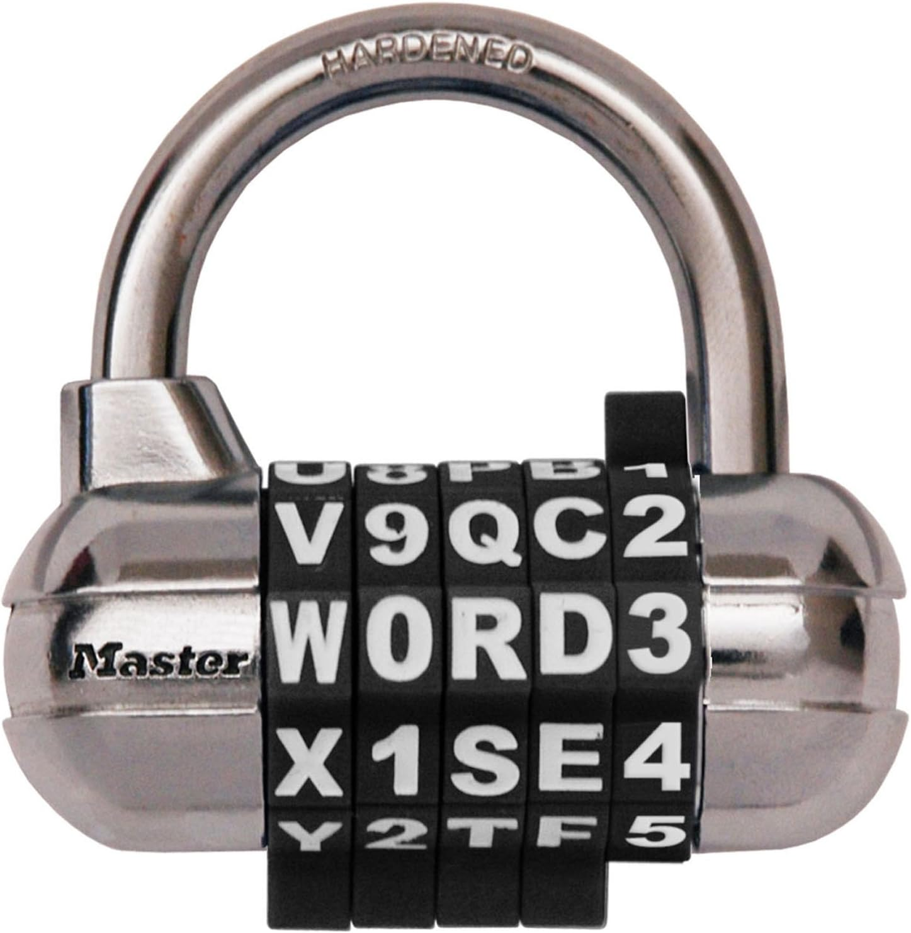
Combination Locks
(Click Images for Pricing)
*Students must memorize code otherwise lock may be clipped and destroyed.

Slide 12
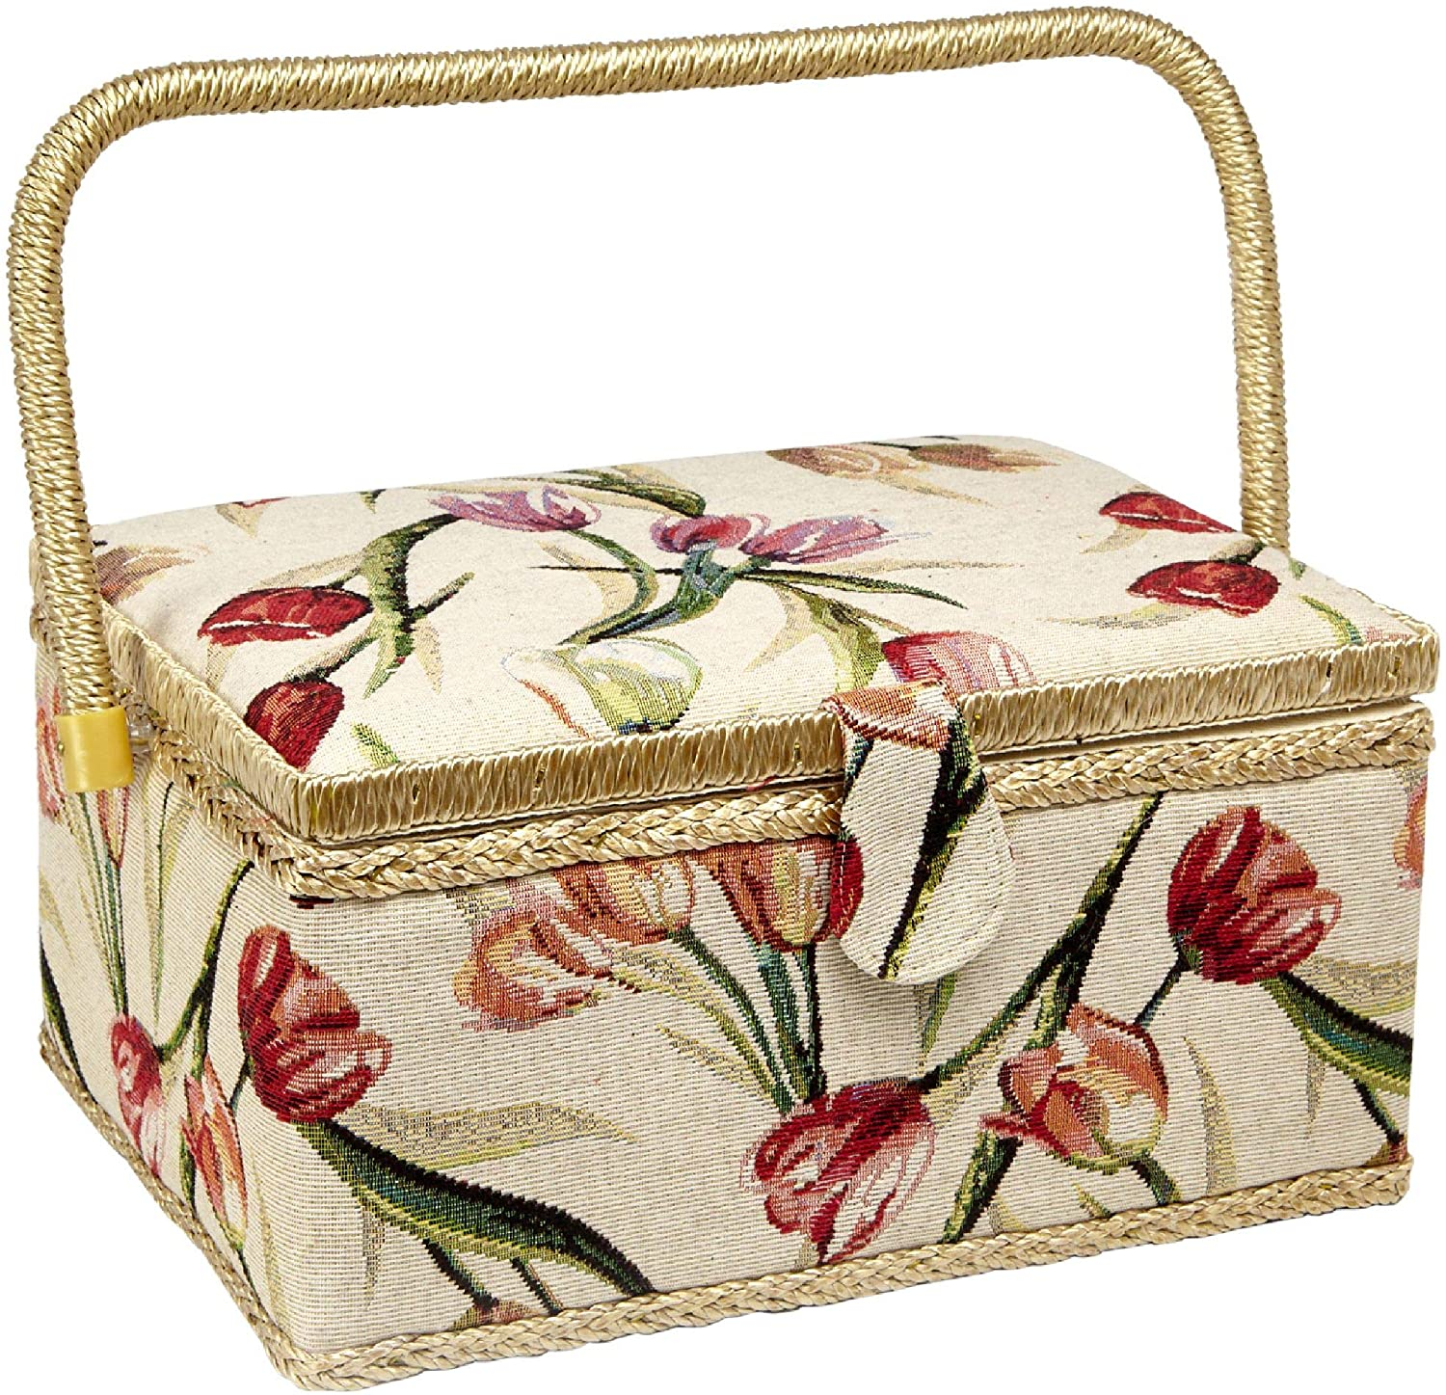
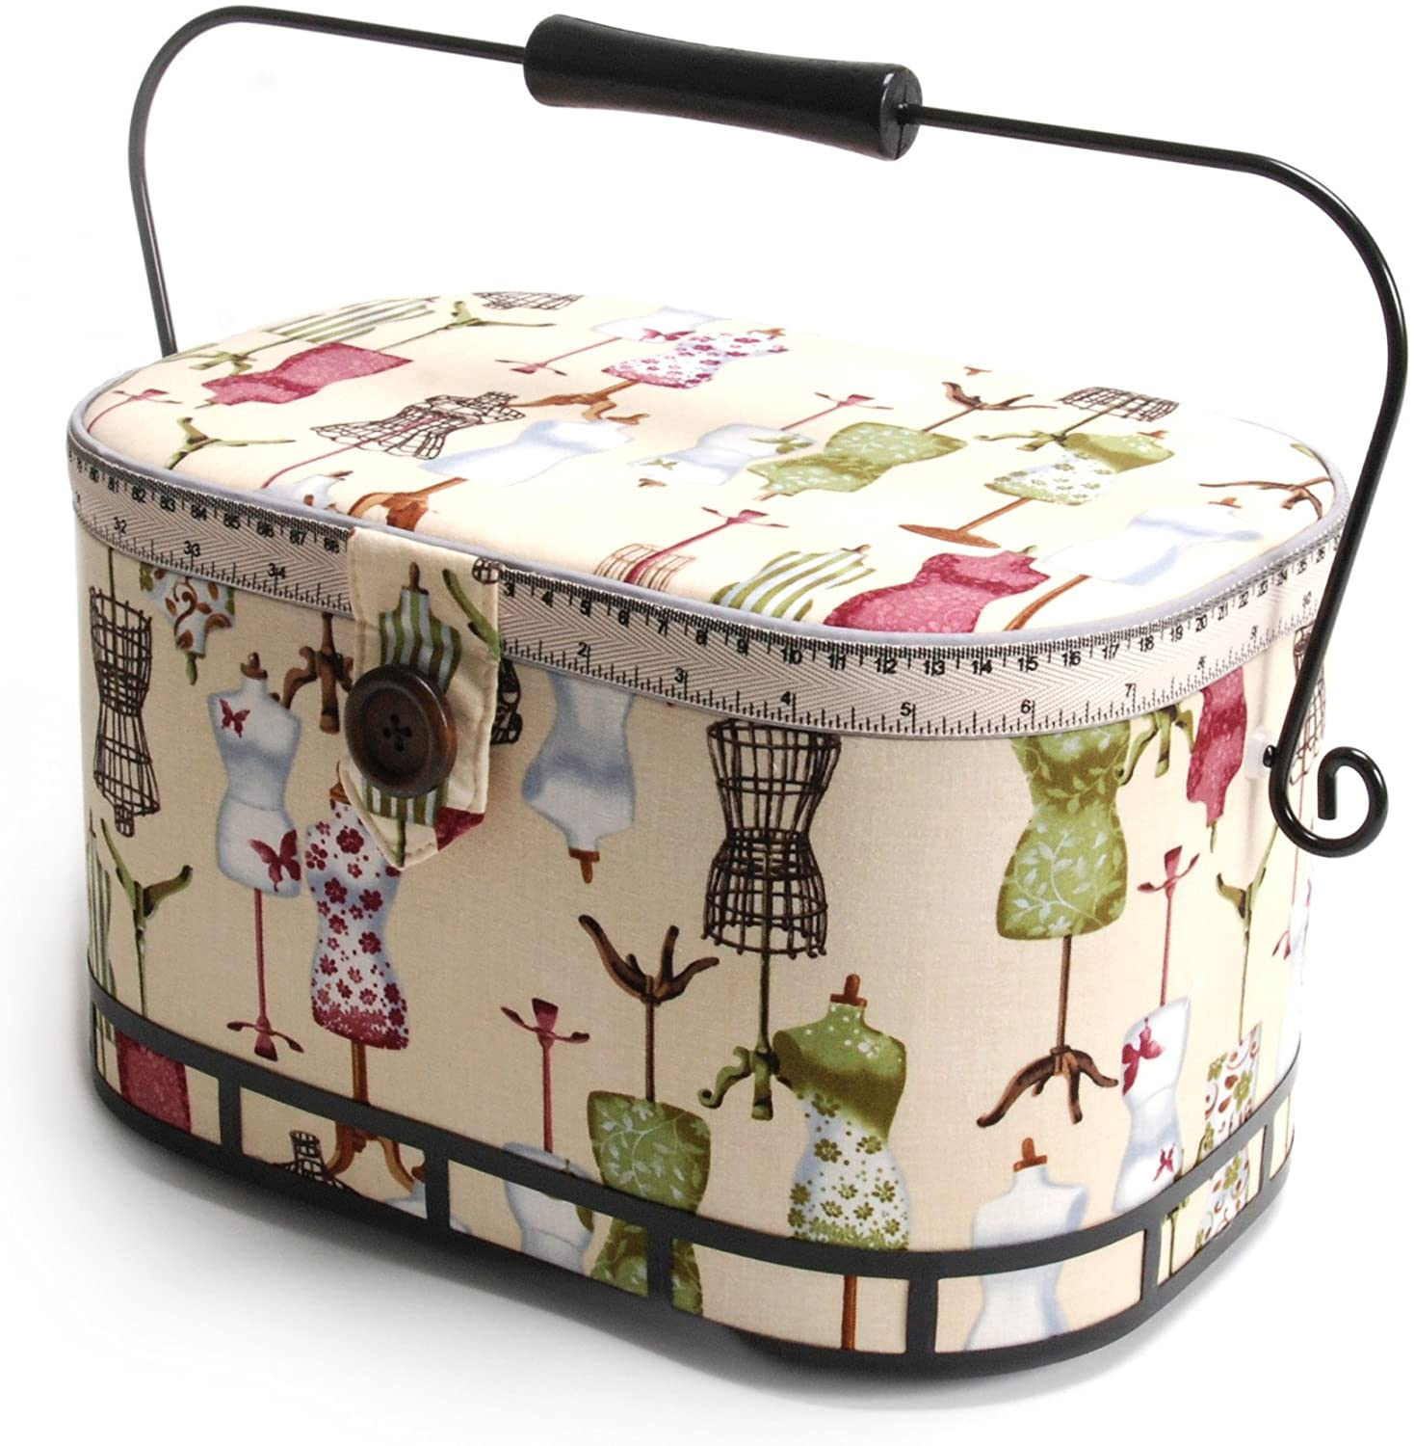
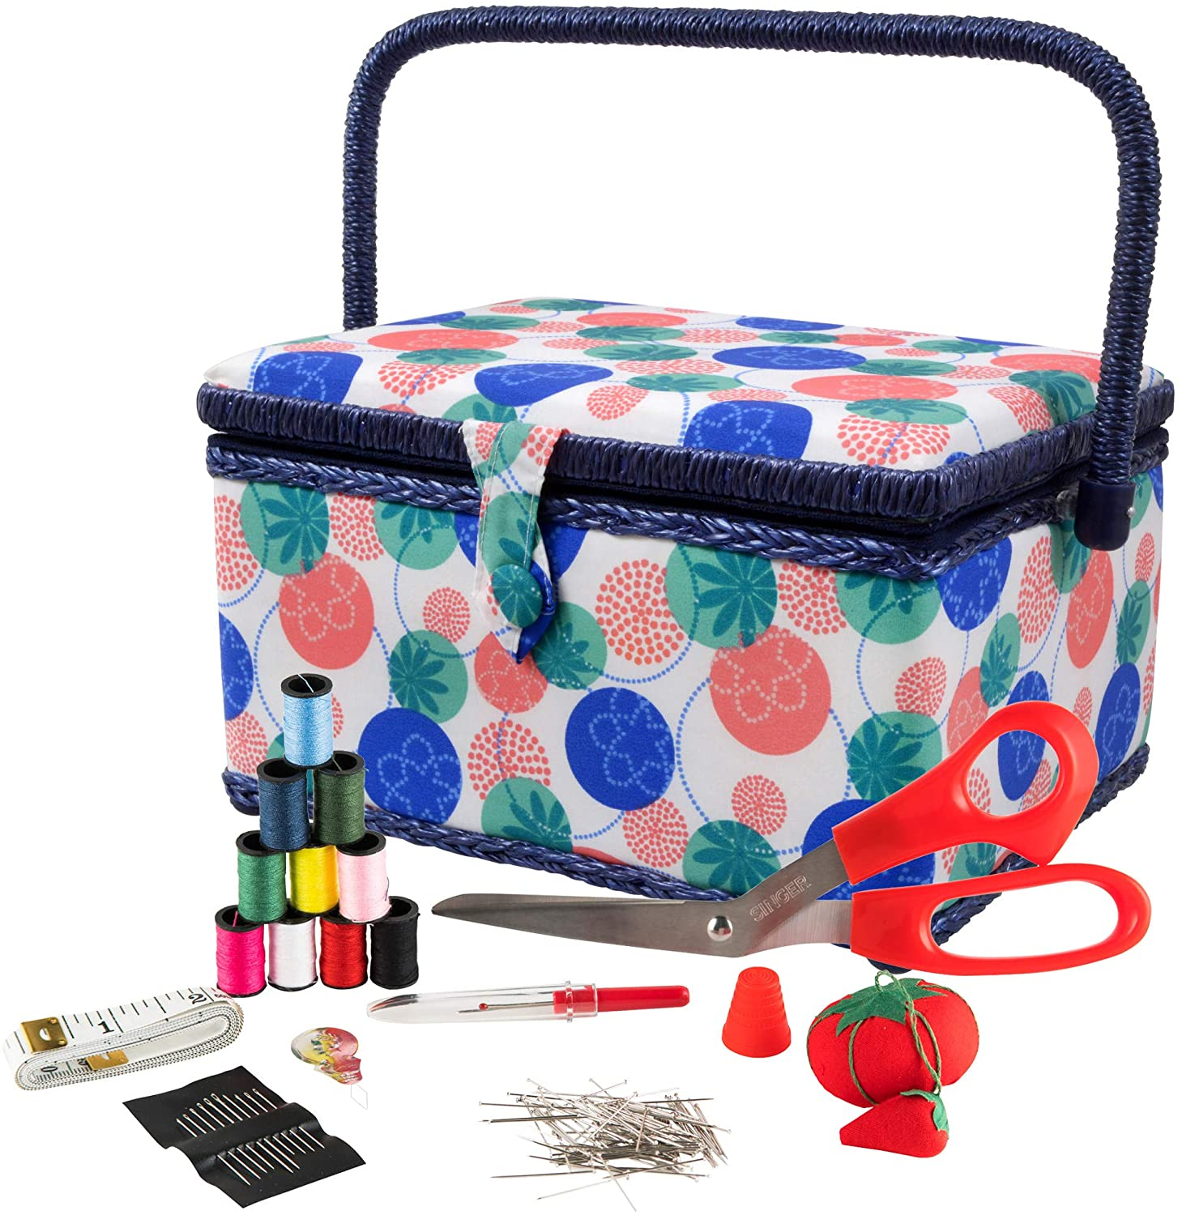
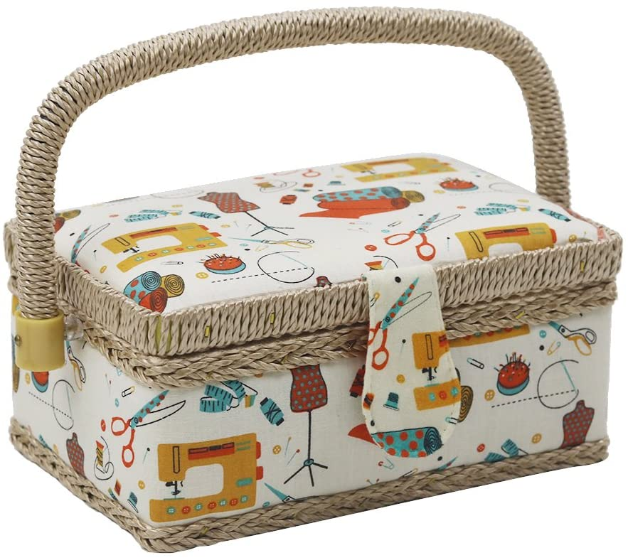
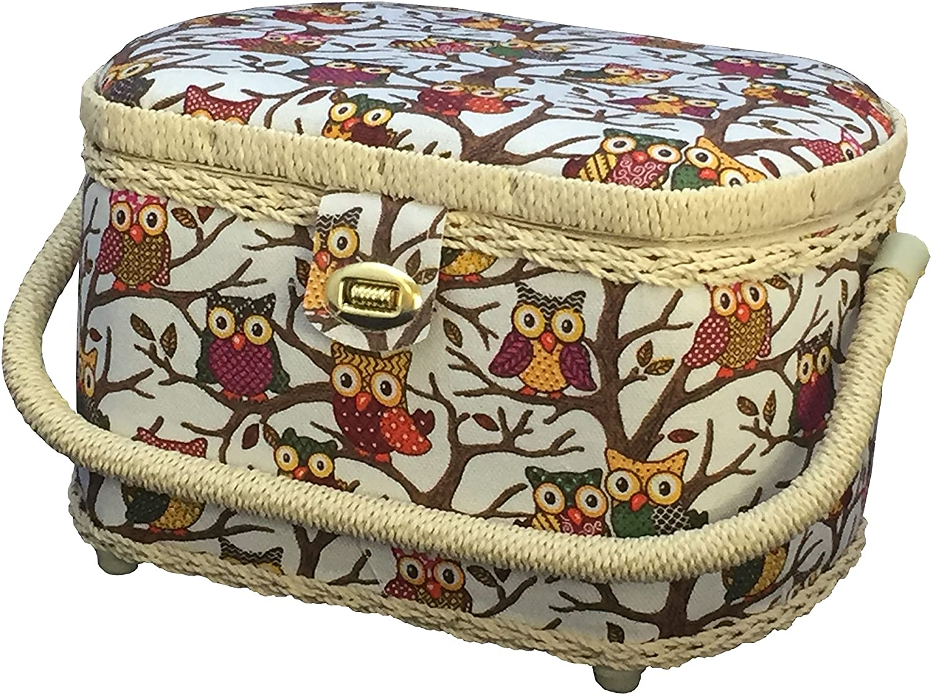
Do Not Buy These Storage Bins (Too Big, bad quality, and too expensive)

Slide 13
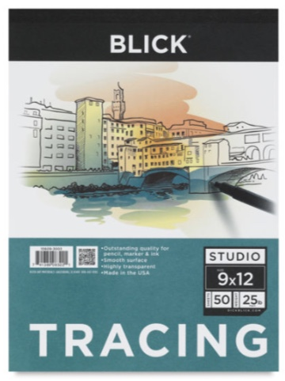
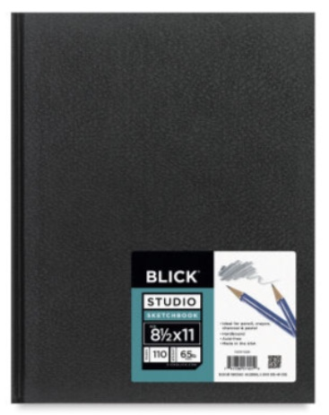
Fashion Art
(Click Images for Pricing)

Slide 14
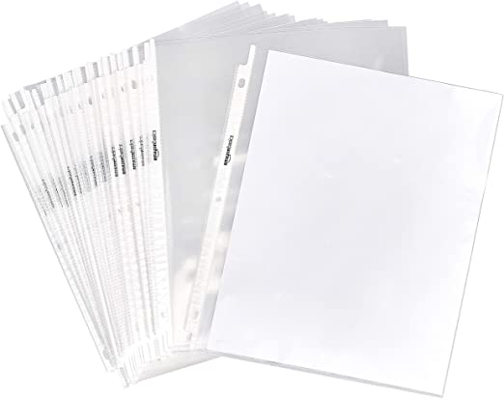
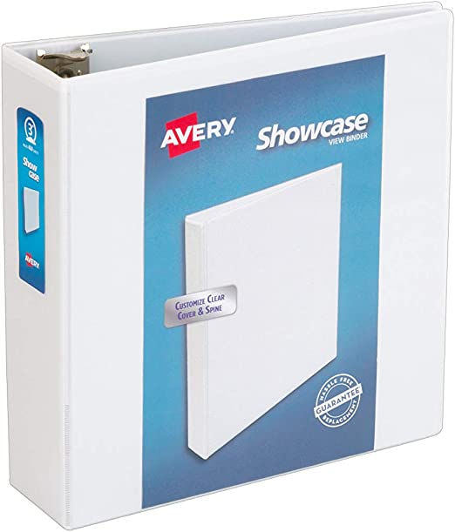
Sewing Sample Book
(Click Images for Pricing)
*Must be a 3 inch spine binder

Slide 15
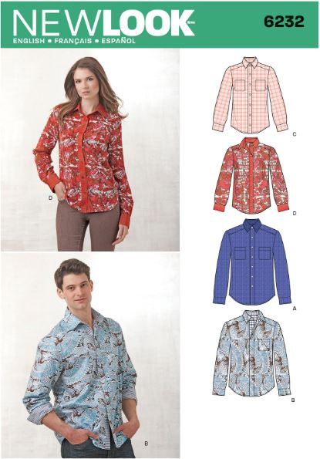
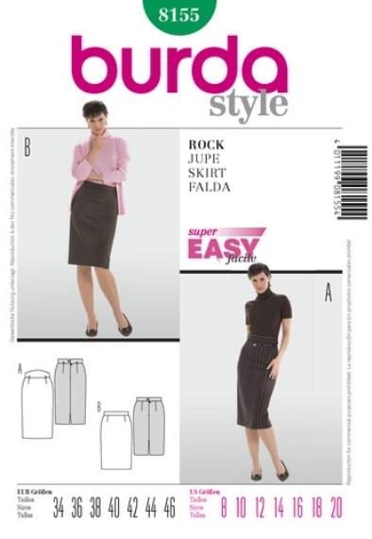
10th Grade Sewing Patterns
(Click Images for Pricing)
*Both patterns are required for introduction to sewing apparel
*Required on the first day of school.

Slide 16
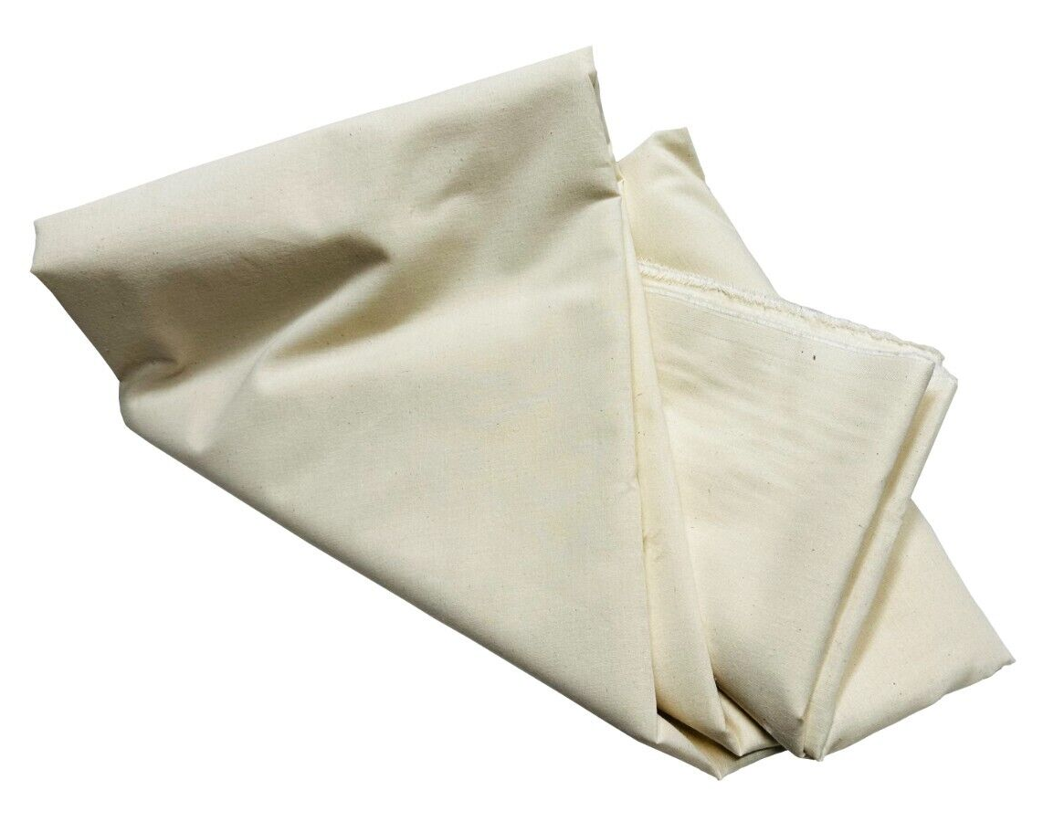
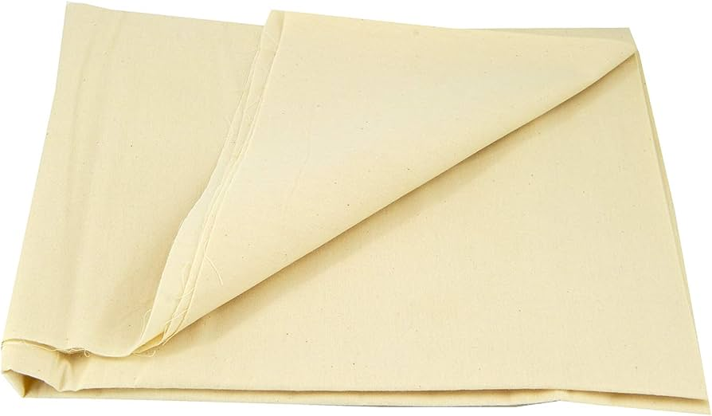
10th Grade 4-5 yards. of Muslin
(Click Images for Pricing)
*Both patterns are required for introduction to sewing apparel
*Required on the first day of school.

Slide 17
Where to Shop
Amazon
https://www.amazon.com/ref=nav_logo
C.H. Martins
2 Palisade Ave, Yonkers, NY 10701
https://www.chmartin.com/
Daytona Trimming
251 W 39th St, New York, NY 10018
https://daytonatrim.com/
Etsy
https://www.etsy.com/market/sewing_supplies
JoAnn
965 Central Park Ave, Scarsdale, NY 10583
https://www.joann.com/
Michaels
Cross County Mall 750 Central Park Ave, Yonkers, NY 10704
https://www.michaels.com/
Panda Internation Trading
247 W 38th St, New York, NY 10018
https://pandatrim.com/
Sewing Machines Etc.
6 North Central Ave. Hartsdale, N.Y. 10530
Sewing Machine Plus
https://www.sewingmachinesplus.com/index.php
SiL Tread
257 W 38th St #1, New York, NY 10018
https://silthreadinc.com/
Wawak Sewing Supplies
https://www.wawak.com/

